Slide 1
Task 3
In this task you are completely free. http://testasp.vulnweb.com/ - This is the website. Explore the website and try to find vulnerabilities in the website and report it to us.

Slide 2
report
TITLE : Cross-Site Scripting
DOMAIN : vulnweb.com
SUB-DOMAIN : testasp.vulnweb.com
SUMMARY :
Found Reflected Cross-Site Scripting vulnerability in the search functionality of your website. As per PortSwigger website definition- Cross-site scripting (also known as XSS) is a web security vulnerability that allows an attacker to compromise the interactions that users have with a vulnerable application. It allows an attacker to circumvent the same origin policy, which is designed to segregate different websites from each other.

Slide 3
STEPS TO REPRODUCE :
Login into your linux system.
Open Firefox >Google and search for given website(http://testasp.vulnweb.com/).
After opening of website, go to search section.
Type something and intercept the request in Burp Suite.
Inside Burp Suite , send that request to intruder.
Paste all the XSS payload and start attack.
You will observe that payload <script>alert(1)</script> is working and you will be getting window alert of 1 after you typed this payload in search box and press enter.
This way we found that the website has XSS vulnerability.

Slide 4
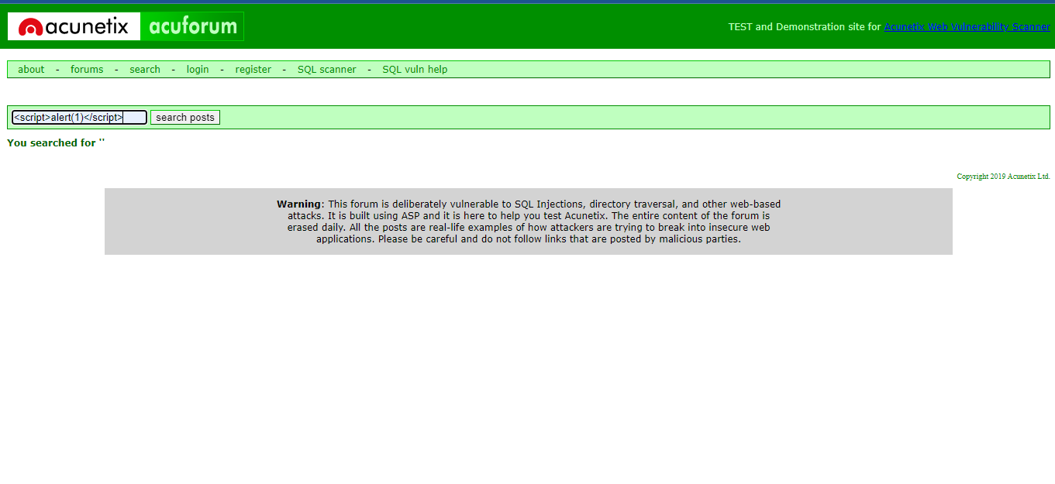
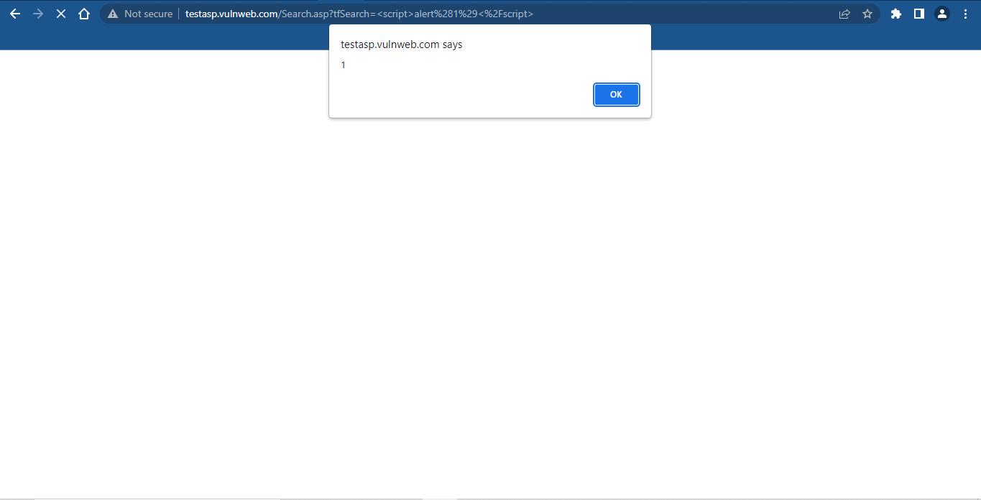
SUPPORTING MATERIALS/REFERENCES:
SCREENSHOT

Slide 5
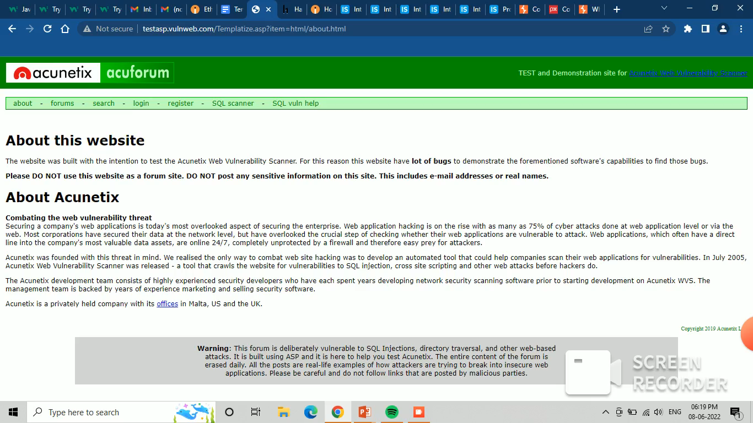
VIDEO DEMONSTRATION:

Slide 6
IMPACT :
Cross-Site Scripting can lead a attacker to impersonate a legitimate user and take over their account which can lead to stealing of data and it can be very harmful for your company/website.
MITIGATION :
If you to want to prevent your website to be vulnerable of Cross-Site Scripting then you can enable noscript on browser. And you must sanitize your input.

